Slide 1
Bazele inteligenței artificiale
Laborator – Grigore Ionuț

Slide 2


today’s lab

Slide 3
Content
Data manipulation in PyTorch
Linear algebra in PyTorch
Automatic differentiation in PyTorch

Slide 4
1) Data manipulation in PyTorch

Slide 5
first lab NumPy + numpy array
this lab PyTorch + tensors
QUESTION: why PyTorch + tensors instead of NumPy + numpy array ?
ANSWER: 1) GPU is well-supported to accelerate the computation with tensor class, whereas numpy only supports CPU computation
2) the tensor class supports automatic differentiation

Slide 6
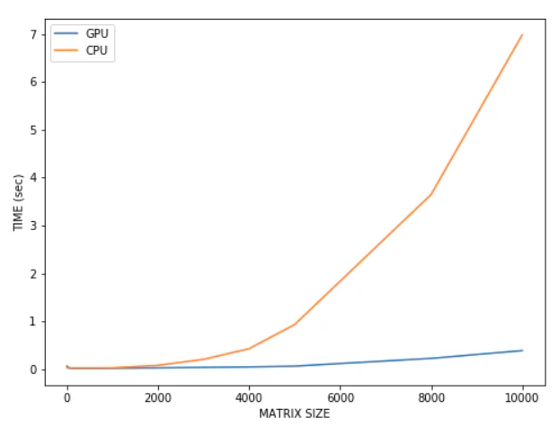
(rows, columns)
NOTE:
In deep learning we have millions/billions of matrix multiplication operations !

Slide 7
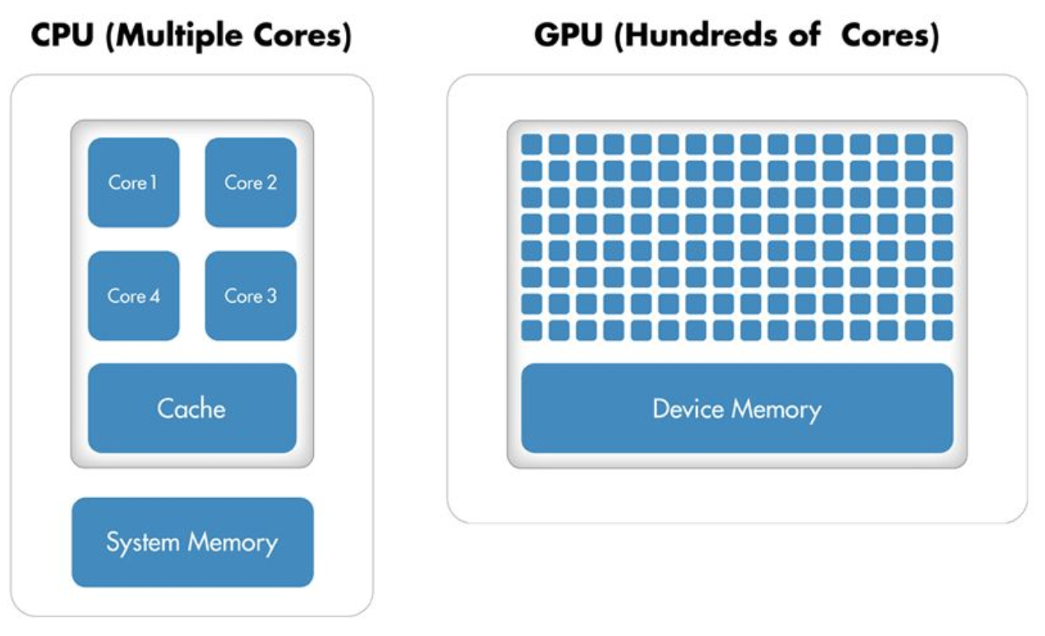
neural networks involve operations that can be parallelized, a strength of GPUs
NOTE:

Slide 8
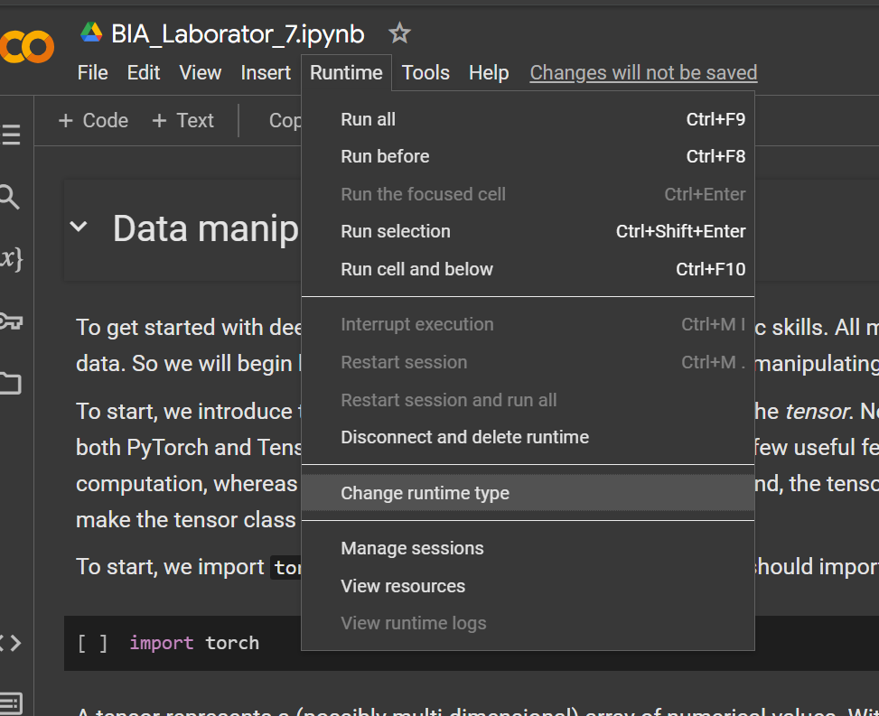
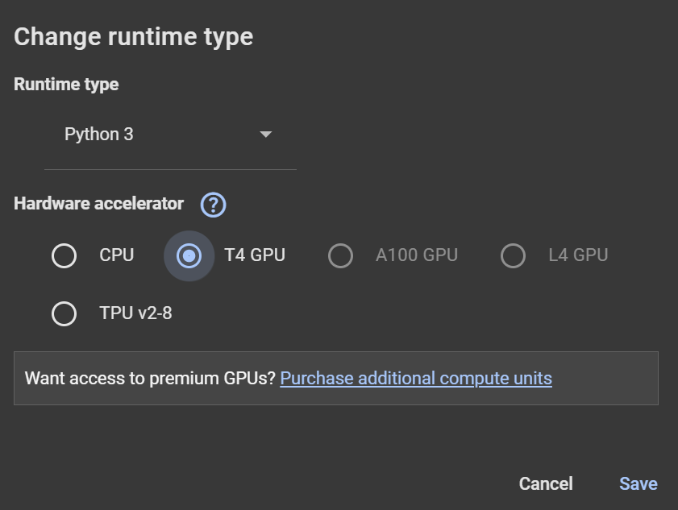

Slide 9

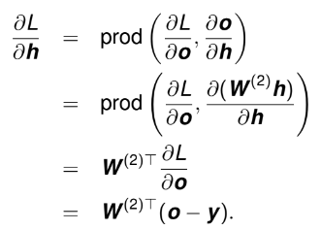



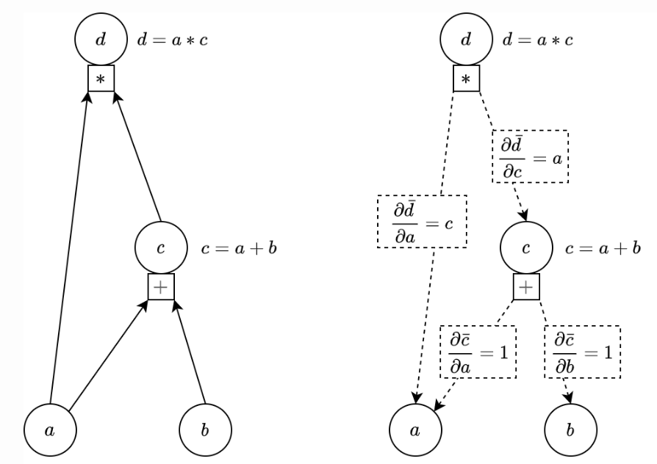

Automatic differentiation
is a computational technique that automatically calculates the derivative of functions with respect to their inputs
we will explain this soon ☺

Slide 10

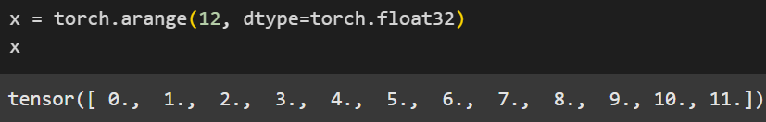

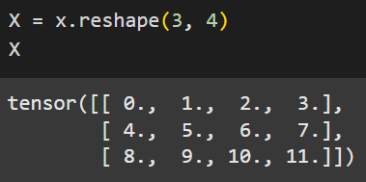

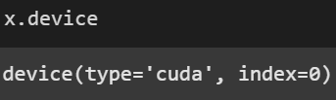




NOTE: although it's called PyTorch, we should import torch, not pytorch
NOTE: Unless otherwise specified, new tensors are stored in main memory and designated for CPU-based computation !

Slide 11






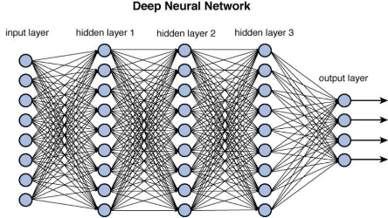
CUDA is a special technology from NVIDIA that allows its GPUs to do more than just graphics.
normally, GPUs are used to render images or videos, but CUDA turns them into powerful calculators.
this is helpful for tasks like training AI models, where we need to do a huge number of calculations very quickly.
+
+

Slide 12
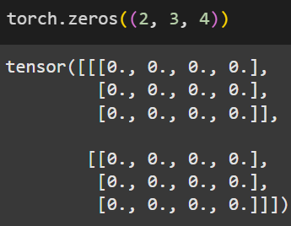
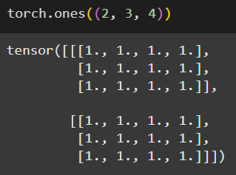
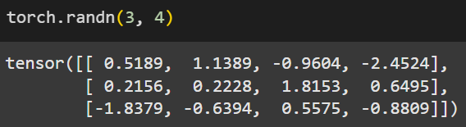
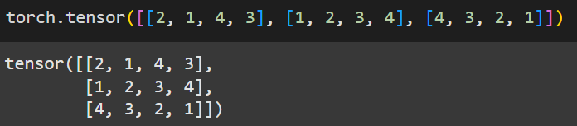
Many ways to create tensors…

Slide 13
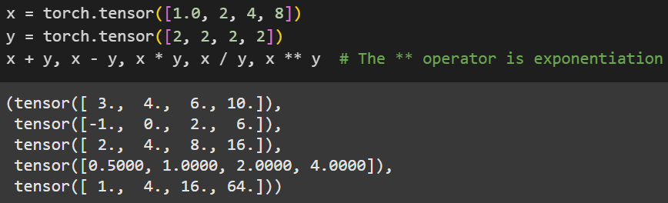


Many mathematical operations…
Ok, maybe not so many here

Slide 14
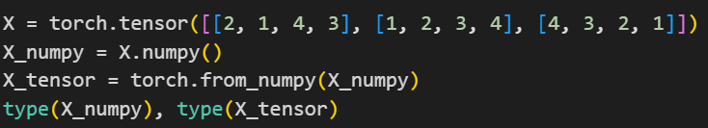
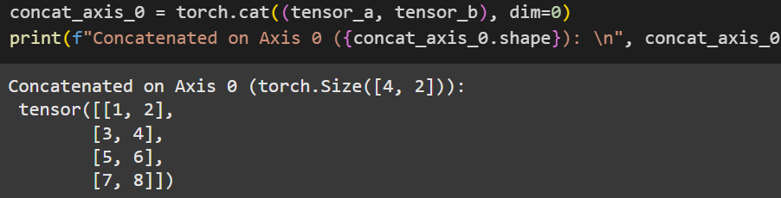
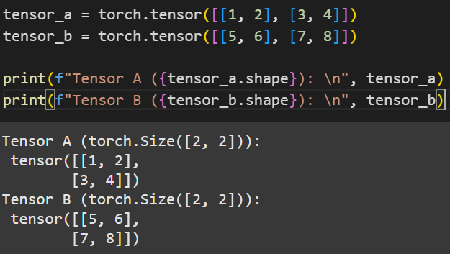
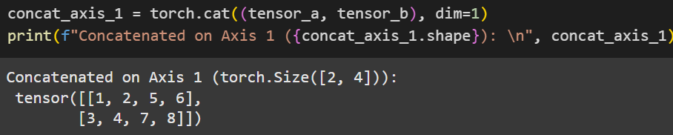
Other useful stuffs…
converting from numpy array to tensor (or viceversa):
concatenating 2 tensors on different axis:

Slide 15
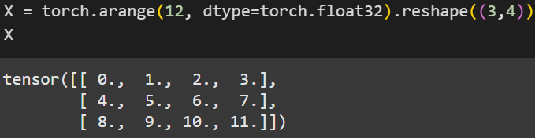
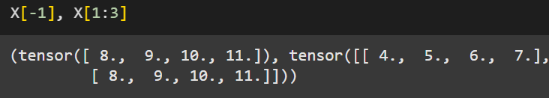
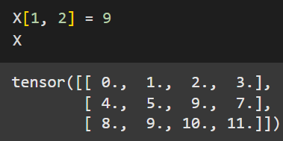
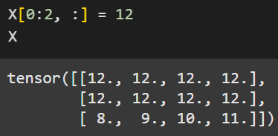
Otherwise we have the same operations as with numpy arrays…
select the last element

Slide 16
2) Linear algebra in PyTorch

Slide 17
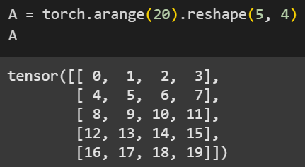
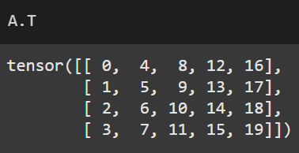
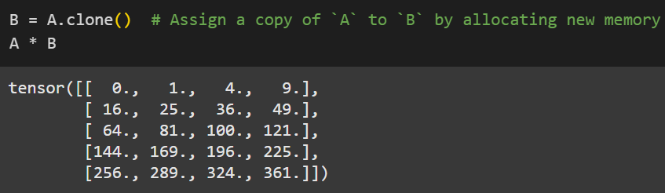
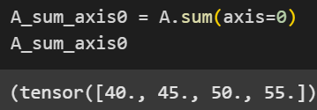
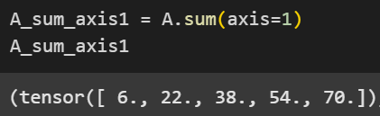



elementwise multiplication

Slide 18
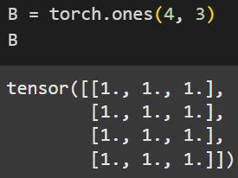
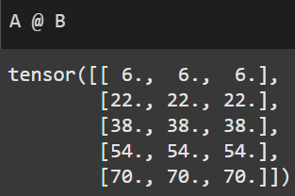
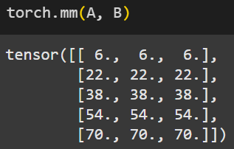
Matrix-matrix multiplication

Slide 19
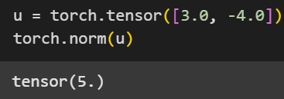
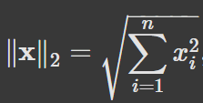


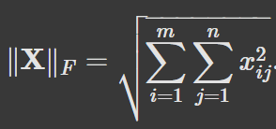

l₁ norm
l₂ norm
Frobenius norm

Slide 20
3) Automatic differentiation in PyTorch

Slide 21
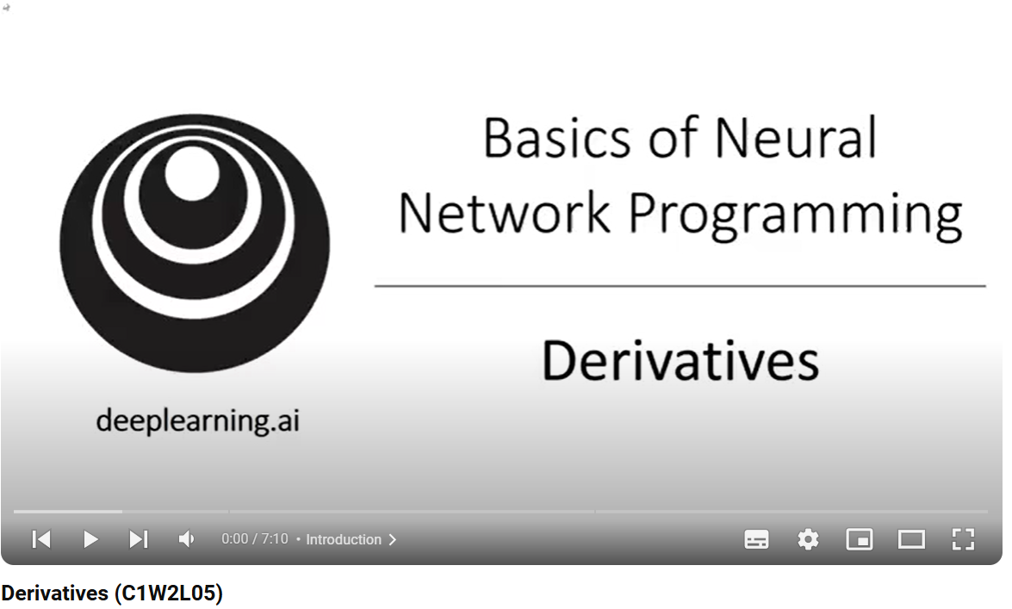
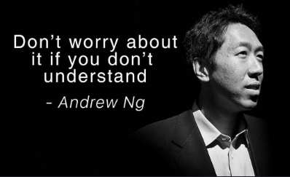
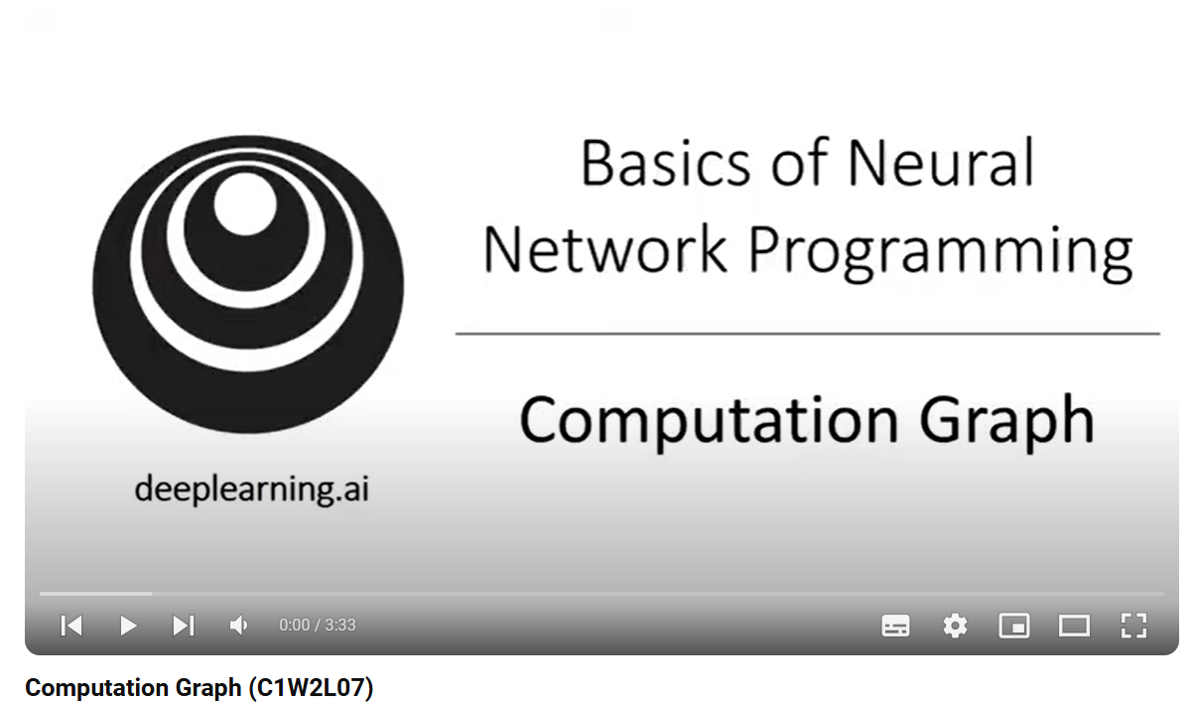
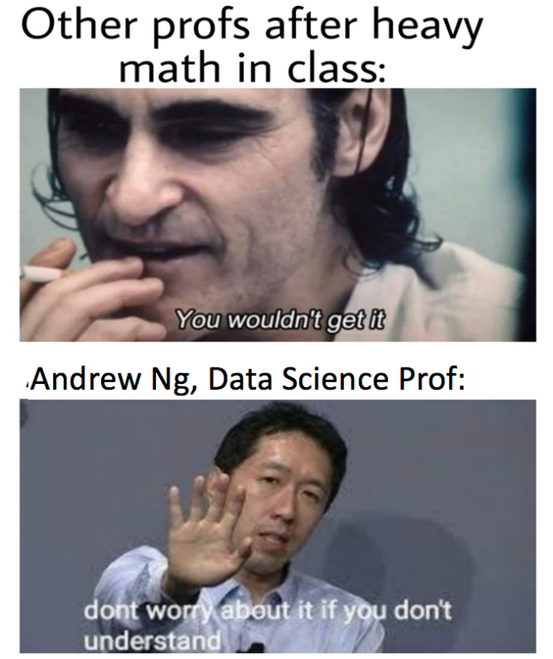
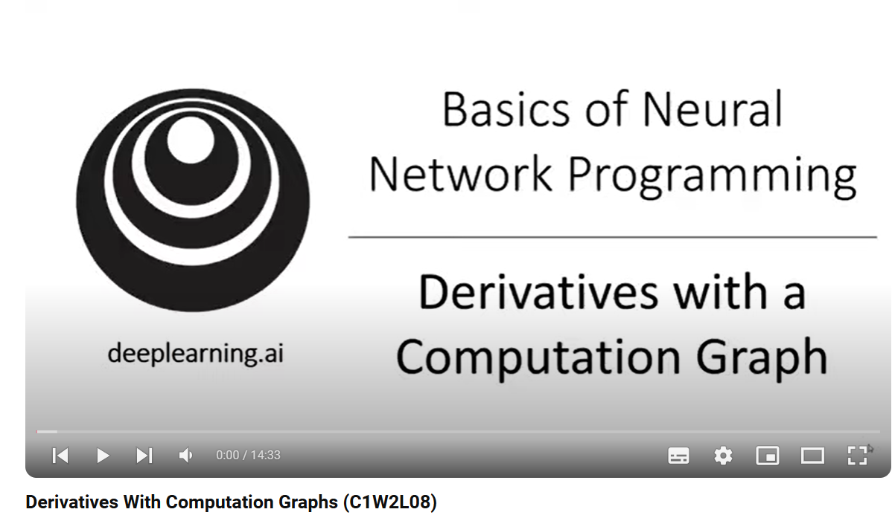

Slide 22
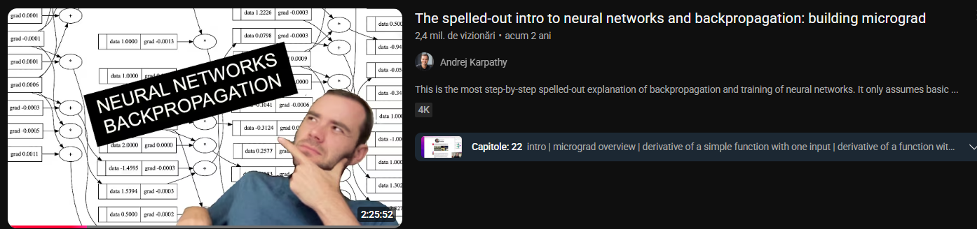
…one of the best video explaining backpropagation:
Andrej Karpathy – co-founded OpenAI

Slide 23
Automatic differentiation (back here ☺)
is a computational technique that automatically calculates the derivative of functions with respect to their inputs

Slide 24
differentiation is a crucial step in nearly all deep learning problems
while the calculations for taking these derivatives are straightforward, requiring only some basic calculus, for complex models, working out the updates by hand can be very complicated (and often error-prone)
deep learning frameworks (PyTorch, Keras, TensorFlow) speed up this work by automatically calculating derivatives, i.e., automatic differentiation
in practice, based on our designed model/neural network, the system builds a computational graph, tracking which data combined through which operations to produce the output
automatic differentiation enables the system to subsequently backpropagate gradients. Here, backpropagate simply means to trace through the computational graph, filling in the partial derivatives with respect to each parameter
= calcularea de derivate/gradienți

Slide 25



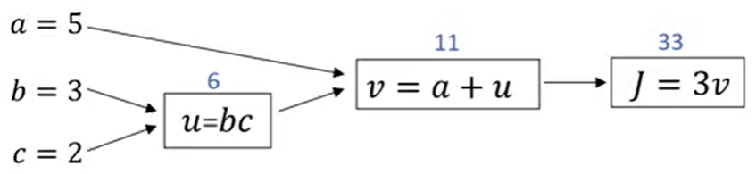














A simple example
Our goal: find , ,

Slide 26

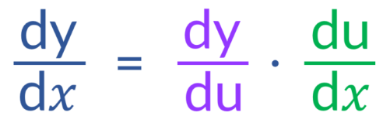







A simple example
Now we use chain rule from high school:
where F(x) = f(g(x))
or
we will use this form !

Slide 27


























A simple example

Slide 28
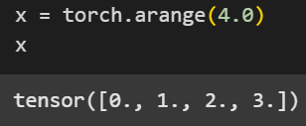

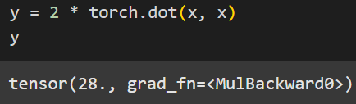
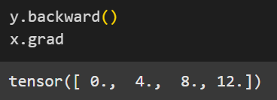




this tells PyTorch to track operations on the tensor and build a computational graph for automatic differentiation (the graph from the previous slides)
or we can simply do

Slide 29




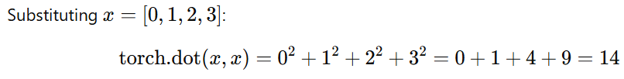
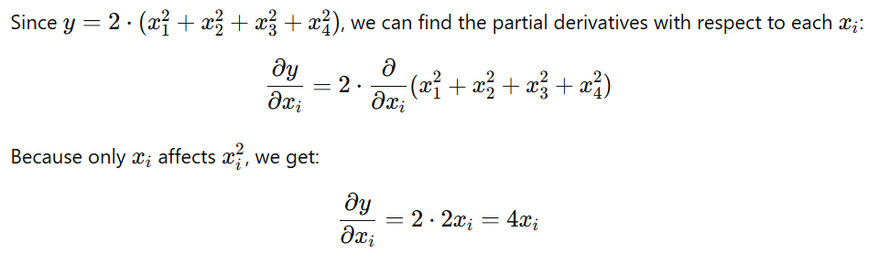
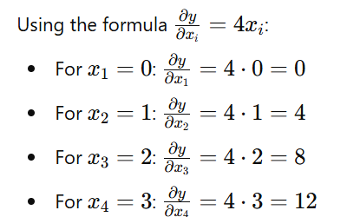

Slide 30

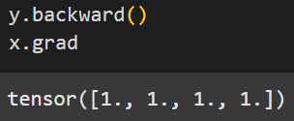

Other example
NOTE:
this operation is essential to avoid accumulating gradients from previous operations
in PyTorch, the gradients are accumulated (summed up) by default in the x.grad attribute whenever backward() is called
this is helpful for cases where you want to accumulate gradients across multiple operations, but it can lead to incorrect or unintended results if you're not explicitly aiming for that

Slide 31
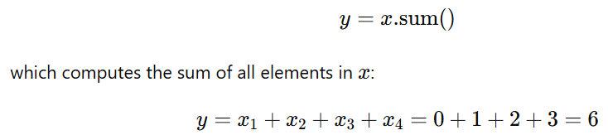






Slide 32
Exercises

Slide 33


Slide 34


Solutions

Slide 35



why this? ☺

Slide 36
by default, y.backward() computes the gradient of y with respect to x, assuming y is a scalar
however, if y is not a scalar (e.g., y has multiple elements like in this case, where y has 3 elements), PyTorch requires you to specify the gradient of y itself
this gradient is often called the "vector of ones“
using torch.ones_like(x) effectively ensures you're computing the derivative of y with respect to x for each component of y, treating each output dimension equally (as having a gradient of 1). This is crucial for multi-dimensional tensors

Slide 37



or you can use y.sum() to achieve the same effect, both variants are correct:
why .sum() works?
  y.sum() collapses the tensor y into a scalar by summing all its elements
  during backpropagation, the gradient of the sum operation assigns a gradient of 1 to each element of y (since the derivative of a sum with respect to each term is 1)
  this is effectively the same as providing torch.ones_like(x) in backward()

Slide 38




Slide 39



Slide 40
Thank you !

